Slide 1


Managing Politics in the Workplace
in a Volatile Year
Presented by:
John G. Stretton

Slide 2
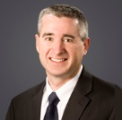
Speaker
John G. Stretton
Stamford, CT
John.Stretton@ogletree.com

Slide 3
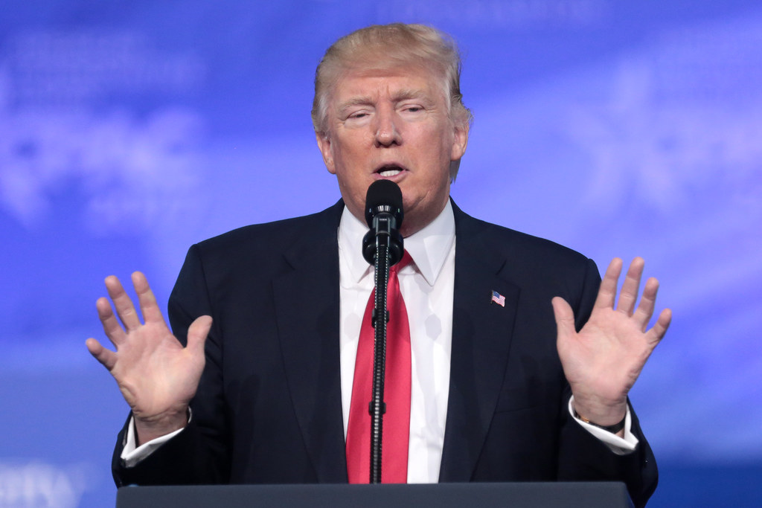
The “HUGE” Overview
Defining and quantifying the problem
Legal Protections
  State & Local Laws
  CT Free Speech Protections
  Recent Executive Order Re: Training
HR Toolkit – What To Do
Real life – scenarios discussion

Slide 4
So What’s The Problem?
Decreased productivity and morale
  Maybe lost talent
Workplace bullying/harassment; workplace violence
Disengagement if ownership/leadership views differ
Company good will with customers, recruits jeopardized
Current social issues are political
  “political” speech about them may be used as evidence of bias
State and local laws create political protections

Slide 5
2020 Election Is Already Impeding Productivity, Collaboration And Employee Morale
78% report discussing politics at work
47% report that the 2020 presidential election has impeded their ability to get their work done
  26% say the election has had a moderate or big impact on their ability to do their job
33% say they now spend more time consuming political news at work
36% report that the 2020 election has led them to avoid talking to a co-worker because of their political views
31% who talk politics at work report being stressed and/or frustrated

Slide 6
Bullying, Harassment, Violence
Many political hot topics implicate protected categories
  Law enforcement funding/practices
  Immigration (SCOTUS decision)
  Right to life v. right to choose
  SCOTUS on LGBTQ protections
  Healthcare/COVID response
Passionate comments on these topics may offend others based on protected characteristics
  Race
  Gender
  National Origin
  Religion
  Age

Slide 7
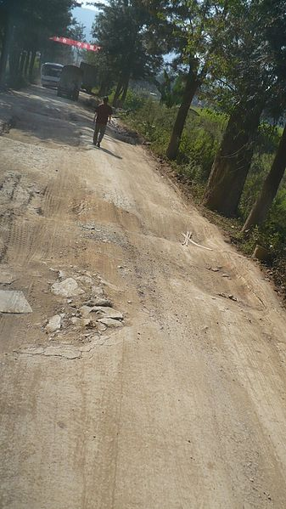
The Next Couple of Months: A Bumpy Road
Political acrimony will increase to and through the Presidential election
The issues are important, the feelings are passionate
  People bring them to work
SOLUTION:
  Know applicable laws
  Proactively issue/revise policies
  Train
  Enforce policies consistently

Slide 8
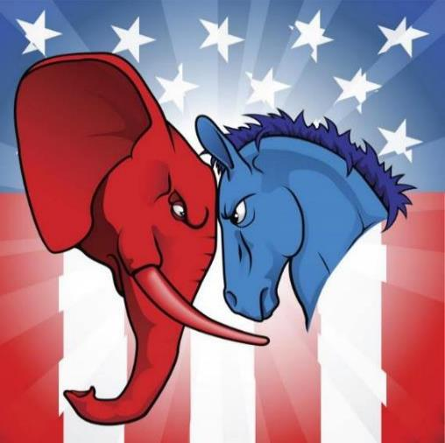
Know (and respect) State/Local Laws
Political affiliation as a protected category
  CA, CO, NV, LA, WA, D.C., Madison, WI
Political activity or belief
  CA, LA, MO, NE, NM, SC
No retaliation against voter
  TX Election Code §276.001 = 3rd degree felony
Captive audience prohibitions
  WI, OR

Slide 9

Know (and respect) State/Local Laws
Time off for voting
Time off to serve as election official/volunteer
  Or attend political convention (TX)
Protections for lawful off-duty conduct
  CA, CO, MN, NY, ND
Protections for use of lawful products
  WI, NV
  Yard signs, bumper stickers, social media
Wrongful discharge exceptions to “at-will”

Slide 10
But What About The First Amendment?
80% of employees believe their political speech at work is protected
United States Constitution
  First Amendment Protection for Free Speech only extends to actions by federal government
  14th Amendment extension of First Amendment protections to states only protects against actions by state and local governments.
First Amendment provides no protections for private employees exercising political speech in the workplace, absent state law protections (like Connecticut)

Slide 11
Scope of Free Speech Protections:
Connecticut State Law
Conn. Gen. Stat. § 31-51q
  Connecticut extends the constitutional protections of freedom of speech to the employees of both private and public employers.
  The employee must show that:
    He/she was speaking as a private citizen - official duties exception
    He/she was commenting on a matter of public concern
    The exercise of his/her right to speak was a motivating factor in the discharge or discipline (the adverse employment action)
    The speech did not substantially or materially interfere with his bona fide job performance

Slide 12
Executive Order on Combating Race and Sex Stereotyping
September 22, 2020 Executive Order prohibits race or sex based stereotyping or scapegoating in any workplace training by government contractors:
  There are a lot of unanswered questions about this Order that will likely be the subject of forthcoming litigation
  Covers any contractor or subcontractor with a contract exceeding $10,000 in a 12 month period with the federal government, as well as employers that receive federal grants and banks or other financial institutions that meet certain criteria
  Does not prohibit discussions of all “privileges” or fact-based historical conversations.
  Effective November 21, 2020: No need to change trainings before this date
  Unlikely that most diversity and inclusion trainings will require complete overhaul
Federal contractors seeking guidance regarding how to restructure their workplace trainings should contact their employment counsel

Slide 13
A Plan To Manage In 2020
Decide the company’s position and educate management to comport their behaviors
Is Company “Neutral”? Then:
  Prohibit sponsoring/hosting gatherings or fundraisers for one party or candidate
  Eliminate political media in the workplace
    Magazines
    Televisions in reception areas or break rooms
If Company is not “neutral,” do not strong arm employees for support
  Prepare for the backlash

Slide 14
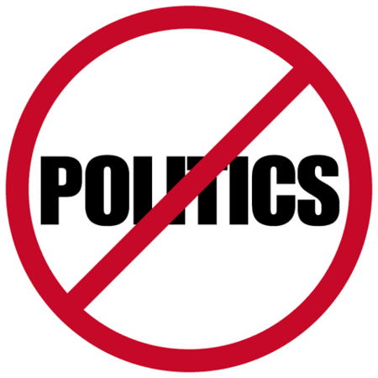
A Plan To Manage In 2020
Train managers:
  On applicable local laws
  Don’t press your political views on employees
  On how to intervene, mollify and redirect political talk at work
  No threats to shut down or slash jobs if one candidate wins
  No paycheck stuffers

Slide 15
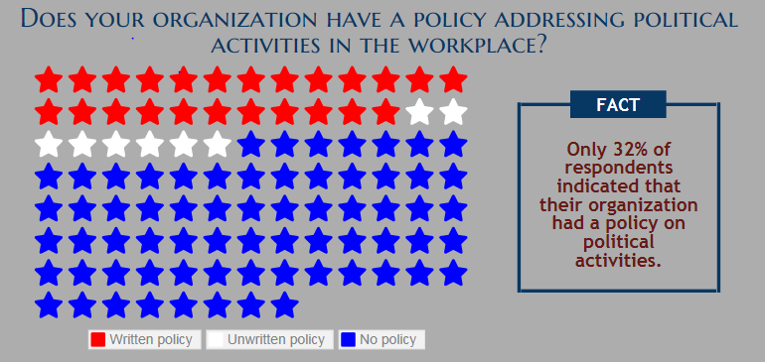
Source: SHRM

Slide 16
A Plan To Manage In 2020
Implement a policy
  Maybe a “no politics” that would:
    Emphasize “Work time is for work”
    Explain: No First Amendment rights here
Prohibit use of company equipment and property to create or display material to promote or oppose any political cause
Prohibit pressuring co-workers on political activities
Prohibit external political activity if connectable to the Company
Train on it and warn of the disciplinary consequences

Slide 17

A Plan To Manage In 2020
Review and shore up pertinent existing policies
  Social media
  Mutual respect/civility
  No distribution/no solicitation
  Voting time off
    Maybe assist employees to obtain mail ballots
Consistently and dispassionately enforce policies when political speech violates them

Slide 18
Preserve Morale and Productivity
Plan ahead to address workplace morale and productivity issues in this election cycle
  Anticipate November 4 and beyond
Possible business solutions:
  Politics-free zones
  Role-modeling
  Well-timed (possibly temporary) increase in workplace perks (e.g., snacks and beverages, etc.)
  Modifications to vendor agreements, delivery deadlines, and quota requirements if slowdowns are anticipated
  An increase in workers’ scheduled hours as appropriate to ensure existing deadlines or quotas are met

Slide 19

Questions?

Slide 20
Thank you!
John G. Stretton
Ogletree, Deakins, Nash, Smoak & Stewart, P.C.
281 Tresser Boulevard, 6th Floor
Stamford, CT 06091
Phone: 203-969-3102
John.stretton@ogletree.com

